Slide 1

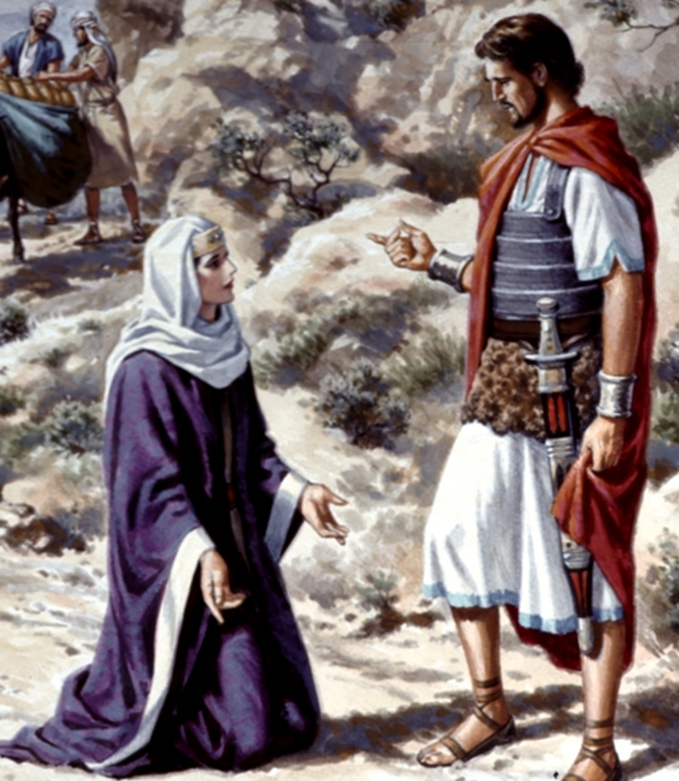
David’s Forgiveness
1 Samuel 25

Slide 2
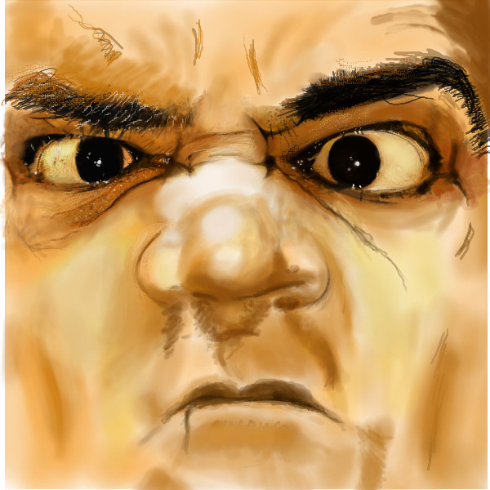
NABAL vs ABIGAIL foolish wise
DIED PROMOTED

Slide 3
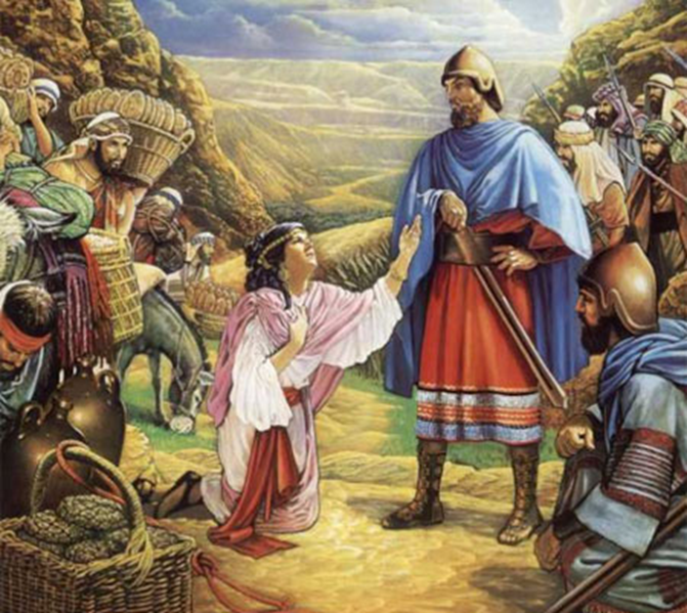
Abigail’s wise courage!
Vs 18: Bringing the peace offering.
Notice: she’s moving to prepare against a day of wrath that she KNOWS is coming.

Slide 4
Job 21:27-32 Behold, I know your thoughts, and the devices which ye wrongfully imagine against me. 28 For ye say, Where is the house of the prince? and where are the dwelling places of the wicked? 29 Have ye not asked them that go by the way? and do ye not know their tokens, 30 That the wicked is reserved to the day of destruction? they shall be brought forth to the day of wrath. 31 Who shall declare his way to his face? and who shall repay him what he hath done? 32 Yet shall he be brought to the grave, and shall remain in the tomb.

Slide 5
Proverbs 11:2-5 When pride cometh, then cometh shame: but with the lowly is wisdom. 3 The integrity of the upright shall guide them: but the perverseness of transgressors shall destroy them. 4 Riches profit not in the day of wrath: but righteousness delivereth from death. 5 The righteousness of the perfect shall direct his way: but the wicked shall fall by his own wickedness.

Slide 6
Romans 2:4-6 Or despisest thou the riches of his goodness and forbearance and longsuffering; not knowing that the goodness of God leadeth thee to repentance? 5 But after thy hardness and impenitent heart treasurest up unto thyself wrath against the day of wrath and revelation of the righteous judgment of God; 6 Who will render to every man according to his deeds:

Slide 7
Abigail went behind Nabal’s back to try and stop David’s wrath.

Slide 8
Revelation 6:17 For the great day of his wrath is come; and who shall be able to stand?

Slide 9
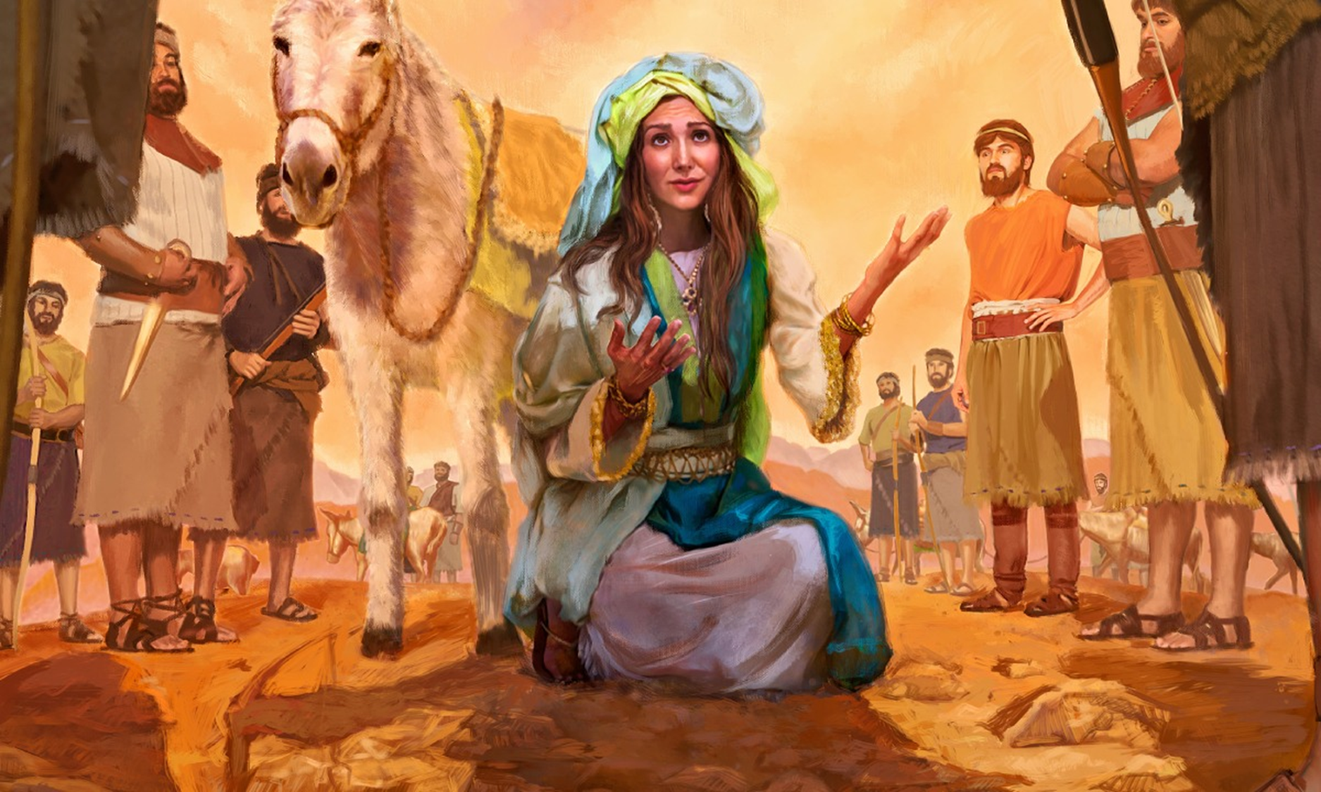
Is one godly woman enough to stand against and army?

Slide 10
Psalm 3:7 Arise, O LORD; save me, O my God: for thou hast smitten all mine enemies upon the cheek bone; thou hast broken the teeth of the ungodly.

Slide 11
Abigail’s was humble at first sight!

Slide 12

KEYS to conflict resolution.
Proverbs 15:1 A soft answer turneth away wrath
1 Corinthians 6:7b Why do ye not rather take wrong? why do ye not rather suffer yourselves to be defrauded?
Acknowledge the sin.

Slide 13
Colossians 2:13-14 And you, being dead in your sins and the uncircumcision of your flesh, hath he quickened together with him, having forgiven you all trespasses; 14 Blotting out the handwriting of ordinances that was against us, which was contrary to us, and took it out of the way, nailing it to his cross;

Slide 14
2 Corinthians 5:21 For he hath made him to be sin for us, who knew no sin; that we might be made the righteousness of God in him.

Slide 15
KEYS to conflict resolution.
Give a soft answer.
Take the wrong.
Acknowledge the sin.
Show the path to a godly resolution.
Ask forgiveness in the place of any offence.
Call on people to forgive.

Slide 16
David’s Forgiveness

Slide 17
Matthew 6:14-15 For if ye forgive men their trespasses, your heavenly Father will also forgive you: 15 But if ye forgive not men their trespasses, neither will your Father forgive your trespasses.
Luke 11:4 And forgive us our sins; for we also forgive every one that is indebted to us. And lead us not into temptation; but deliver us from evil.

Slide 18
Proverbs 11:16a A gracious woman retaineth honour:
Proverbs 31:10 Who can find a virtuous woman? for her price is far above rubies.

Slide 19
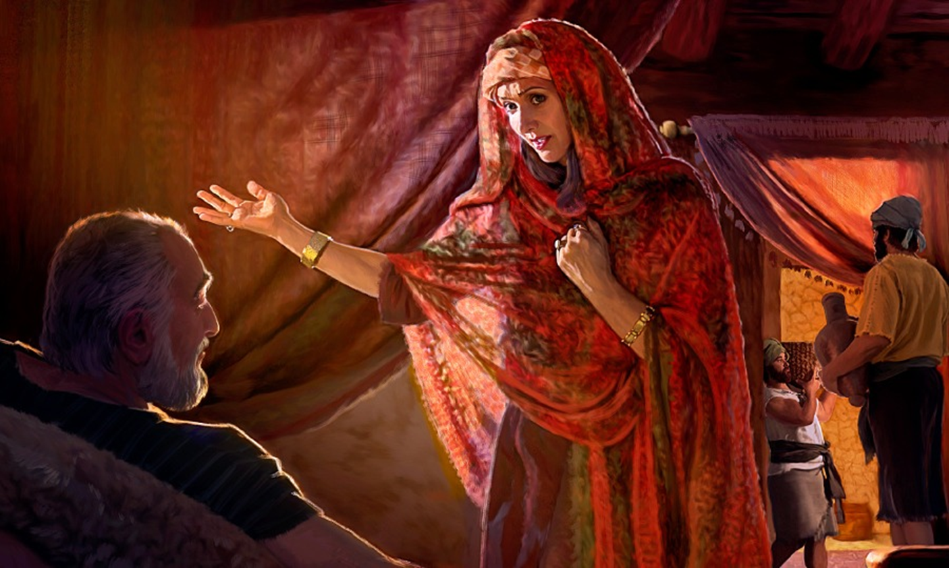
God’s final judgment.

Slide 20
David’s response is dispensationally appropriate.
Today, biblically, we should hate every false way.
Let’s keeps our dispensations straight.

Slide 21
Luke 23:34 Then said Jesus, Father, forgive them; for they know not what they do. And they parted his raiment, and cast lots.
Romans 5:8 But God commendeth his love toward us, in that, while we were yet sinners, Christ died for us.
Ephesians 4:32 And be ye kind one to another, tenderhearted, forgiving one another, even as God for Christ's sake hath forgiven you.

Slide 22
David’s Forgiveness
1 Samuel 25

